Slide 1
IMPLEMENTING IPSAS
Property, Plant and Equipment
IPSAS® 45
2024 Edition
Notes:
IPSAS 45 is based on IAS 16, Property, Plant and Equipment. Participants who are familiar with IAS 16 should be comfortable with IPSAS 17 as long as the key differences are noted.
IPSAS 45 was issued in May 2023 and replaces IPSAS 17 for periods beginning on or after January 1, 2025.

Slide 2
The Handbook of International Public Sector Accounting Pronouncements is the primary authoritative source of international generally accepted accounting principles for public sector entities.
All information in this presentation is proprietary and copyrighted.
Property, Plant and Equipment

Slide 3
Definition of Property, Plant, and Equipment (PP&E)
Property, Plant, and Equipment are tangible items that:
Are held for use in the production or supply of goods or services, for rental to others, or for administrative purposes; and
Are expected to be used during more than one reporting period.
Weapons systems and infrastructure assets meet the definition
Tangible heritage assets meet the definition
Property, Plant and Equipment
Notes:
If participants are not familiar with accrual accounting, an additional slide with examples of PP&E from their jurisdiction could be included here.
Similarly, for entities that are adopting accrual accounting for the first time, identifying PP&E is often one of the most significant tasks. Entities should consider what records could be used to identify those assets. This could be discussed (and a separate slide included if this would be useful) if participants are in the process of implementing accrual IPSAS for the first time.
Examples of records include:
Land registries or similar land ownership registers.
Utility bills (gas/electricity/oil/water/telecoms) can identify buildings where costs are being incurred.
Maintenance contracts can be used to identify assets
Asset registers
Rental income
Records may be incomplete or out of date, and as well as identifying assets to be recognized, might identify costs that are being incurred for assets that the entity no longer controls.

Slide 4
Scope Limitations
Does not apply to:
Biological assets related to agricultural activity (with the exception of bearer plants, which are in the scope of IPSAS 45)
Mineral reserves such as oil, natural gas and similar non-regenerative resources
Property, plant, and equipment classified as held for sale (see IPSAS 44, Non-current Assets Held for Sale and Discontinued Operations
The recognition and measurement of exploration and evaluation assets
Property, Plant and Equipment
Notes:
Last two bullets introduced in IPSAS 45. Exclusion of non-current assets held for sale will only apply under IPSAS 17 where IPSAS 44 has been adopted before IPSAS 45.

Slide 5
Recognition Principle
The cost of an item of property, plant, and equipment shall be recognized as an asset if, and only if:
It is probable that future service potential or economic benefits associated with the item will flow to the entity; and
The item can be measured reliably.
Property, Plant and Equipment
Notes:
Item can be measured reliably if its cost or deemed cost can be measured reliably, See IPSAS 46 / Module 10 for the discussion on deemed cost (brief summary in speaker notes to Slide 9)

Slide 6
Recognition Issues Example
A municipality has spent CU 12 million to install equipment at its water treatment facility to meet new provincial water quality regulations. The equipment has had no effect on the quality and volume of the water treated or the expected life of the treatment plant.
Should the expenditure be capitalized as PP&E? Explain
Property, Plant and Equipment
Notes:
Answer:
The expenditure does not strictly meet the recognition criteria. The equipment required to comply with water quality standards does not provide future economic benefits or service potential. However, it is appropriate to treat the upgrade as PP&E.
Although equipment does not directly embody future economic benefits or service potential, it is necessary for a municipality to obtain future economic benefits or service potential from its water treatment plants.
Items of property, plant, and equipment may be required for safety or environmental reasons. The acquisition of such property, plant, and equipment, although not directly increasing the economic benefits or service potential of any particular existing item of property, plant, and equipment, may be necessary for an entity to obtain the economic benefits or service potential from its other assets. Such items of property, plant, and equipment qualify for recognition as assets.
For example, fire safety regulations may require a hospital to retrofit new sprinkler systems. These enhancements are recognized as an asset because, without them, the entity is unable to operate the hospital in accordance with the regulations.
However, the resulting carrying amount of such an asset and related assets is reviewed for impairment in accordance with IPSAS 21, Impairment of Non-Cash- Generating Assets.

Slide 7
Other Recognition Issues
Spare parts and servicing equipment
Major parts, and standby equipment
Aggregation of items
Property, Plant and Equipment

Slide 8
Recognition Examples
Scenario 1 - A hospital has installed two identical back-up generators to provide electric power when there is a power disruption. The second generator will be used in the unlikely event that the first generator fails.
Scenario 2 - A local government maintains a supply of spare backup electric motors in its water treatment plant. The motors are readily available from suppliers in the market.
How should the costs be recognized under each scenario? Why?
Property, Plant and Equipment
Notes:
Answers:
Scenario 1 - Both back-up generators are items of property, plant and equipment. Both are expected to be used, although irregularly, during more than one period. Major spare parts and stand-by equipment qualify as property, plant, and equipment when an entity expects to use them during more than one period.
Scenario 2 - It depends! Professional judgment would have to be exercised in determining the appropriate accounting treatment. Generally, spare parts and servicing equipment are carried as inventory and expensed in surplus or deficit as consumed except when the items meet the definition of PP&E and are significant or the items can only be used in connection with another item of property, plant and equipment. In this latter case, they are capitalized.
In this case, since the electric motors are commonly available in the market, they could be recognized as inventory and expensed in surplus or deficit as consumed. Alternatively, if it is determined that they satisfy the definition of PP&E, are significant or can only be used in connection with the water treatment plant, they could be capitalized.

Slide 9
Initial Measurement
An item of PP&E that qualifies for recognition as an asset is measured at its cost
Elements of cost includes
Purchase price (including import duties/taxes net of trade discounts and rebates)
Costs directly attributable
Estimate of obligations associated with retirement, disposal or abandonment
An item acquired in a non-exchange transaction is measured at its deemed cost. Deemed cost is measured by applying IPSAS 46, Measurement
Property, Plant and Equipment
Notes:
Note that IAS 16 does not include any specific provisions regarding items acquired in non-exchange transactions. If participants are familiar with IAS 16, the non-exchange transaction provisions should be highlighted.
For property, plant, and equipment, deemed cost may be fair value (where the asset it held for its financial capacity) or current operational value (where the asset is held for its operational capacity).

Slide 10
Measurement Example
A municipality has acquired land and a building to be develop into a parking structure. The building is to be demolished.
How would the acquisition be accounted for? Explain
The property is used temporarily for surface parking pending construction.
Is the surface parking operation part of the cost of the new parking structure? Explain
Property, Plant and Equipment
Notes:
Answer:
An item of property, plant, and equipment that qualifies for recognition as an asset should be measured at its cost. The elements of cost of an item of property, plant, and equipment comprises its purchase price and any costs directly attributable to bringing the asset to the location and condition necessary for it to be capable of operating in the manner intended by management.
The demolition of the building would be considered costs of bringing the land to condition for its intended use and included in the carrying amount of the land.
Some operations occur in connection with the construction or development of an item of property, plant, and equipment, but are not necessary to bring the item to the location and condition necessary for it to be capable of operating in the manner intended by management.
These incidental operations may occur before or during the construction or development activities. Because incidental operations are not necessary to bring an item to the location and condition necessary for it to be capable of operating in the manner intended by management, the revenue and related expenses of incidental operations are recognized in surplus or deficit, and included in their respective classifications of revenue and expense.

Slide 11
Measurement after Initial Recognition
Historical Cost Model - property, plant, and equipment is carried at its historical cost, less any accumulated depreciation and any accumulated impairment losses.
Current Value Model - property, plant, and equipment whose current value can be measured reliably is carried at a revalued amount, being its current operational value or fair value at the date of the revaluation, less any subsequent accumulated depreciation, and subsequent accumulated impairment losses.
Property, Plant and Equipment
Notes:
Revaluation gains and losses are taken to revaluation surplus (a component of net assets/equity). This is equivalent to taking changes to Other Comprehensive Income under IAS 16. If participants are familiar with IFRS, this difference should be highlighted.
Note that under IPSAS 17, revaluation surplus balances are maintained for each class of asset. Under IAS 16, balances are maintained for each asset. If participants are familiar with IFRS, this difference should be highlighted.
The current value model is not covered in depth in this material because of the complexity of the accounting is beyond its scope. If your public sector entity chooses to use the current value model, reference should be made directly to IPSAS 45.

Slide 12
Comparison of Models
 | Historical Cost Model | Current Value Model
Initial Recognition | Cost (cash price equivalent) or deemed cost at date of acquisition
Subsequent | Original cost | Current operational value or fair value at date of revaluation
Carrying Amount | Original cost less accumulated depreciation and impairment losses since recognition | Revalued amount less accumulated depreciation based on revalued amount and impairment losses subsequent to revaluation date
Property, Plant and Equipment

Slide 13
Pros and Cons of Current Value Model
Advantages | Disadvantages
Provides more relevant information | Administrative costs
Depreciation reflects true cost of using assets | Complex ongoing accounting adjustments
Provides better information for accountability and decision making | Volatility in reported results
Improves asset management | Revalued amounts are not renewal costs required to sustain service levels
Property, Plant and Equipment

Slide 14
Depreciation
All PP&E with a finite useful life is subject to depreciation
Rebuttable presumption that non-land items of PPE have a finite useful life
The depreciable amount of an asset is expensed on a systematic basis over its useful life to surplus or deficit for each period unless it is recognized in the carrying amount of another asset
Depreciation begins when an asset is in operation
Depreciation ends at the earlier of when an asset is classified as held for sale or derecognized
Reviewed at each annual reporting date
Each significant component is depreciated separately
Property, Plant and Equipment
Notes:
Land will generally have an indefinite useful life. Some heritage assets may also have an indefinite useful life, and therefore not be subject to depreciation. See Module 2 for more details.
If participants’ organizations have significant heritage assets, consider a discussion about how to assess their useful life and whether it will therefore be appropriate to depreciate them.
See IPSAS 44, Non-current Assets Held for Sale and Discontinued Operations and Module 8 for details of when an asset should be classified as held for sale.
Heritage assets are discussed further in Slides 17 and 18. Infrastructure assets are discussed further in Slides 19 and 20.

Slide 15
Depreciation Example
A government has a water treatment facility with the following components:
Assuming it was in service Jan 1, 20x0, has no residual value and is depreciated on a straight line depreciation, what is the depreciation for year ended of Dec 31, 20x0? Explain
How should the treatment facility be recognized?
Component | Cost (CU) | Expected Life
Building Structure | 2,000,000 | 40 Years
Roof | 500,000 | 15 Years
Pumps | 1,000,000 | 10 Years
HVAC System | 500,000 | 15 Years
Property, Plant and Equipment
Notes:
The answer to this discussion question is provided in the Assets module (pages 29).

Slide 16
Derecognition
The carrying amount of PP&E is derecognized:
On disposal
When no future service potential or economic benefits is expected from its use or disposal
Gain or loss on derecognition is included in surplus or deficit
A replaced component is derecognized
Property, Plant and Equipment

Slide 17
Heritage Assets – Decision Tree
Is the PPE a Heritage Item?
Do the benefits associated with the PPE flow to the entity?
Cost or current value can be measured reliably?
Recognize as heritage asset in accordance with IPSAS 45
Yes
Yes
Yes
No
No
No
Entity applies IPSAS 45 without consideration of heritage aspects
Do not recognize an asset
Not recognized – provide required disclosures in IPSAS 45
Property, Plant and Equipment

Slide 18
Useful Life of Heritage Assets
For a heritage asset to have an indefinite useful life, an analysis of the relevant factors should show that it is reasonable to consider that there is no foreseeable limit to the period over which it is expected to provide service potential
Examples include a heritage painting or sculpture held in a protective environment that is carefully controlled to preserve the asset
Main factors to consider:
Period providing service potential – to the best of the entity’s knowledge, the asset is expected to provide service potential indefinitely
Usage – should not result in physical wear and tear to the asset
Preservation – past actions known and preservation plan in place
Property, Plant and Equipment
Notes:
IPSAS 45 includes a rebuttable presumption that non-land items have a finite useful life. Therefore, need to be able to show that is reasonable to consider that there is no foreseeable limit to the period over which a heritage asset can be expected to provide service potential. The example given is artwork in a protective environment. This should prevent any physical deterioration of the asset, allowing the asset to provide heritage service potential indefinitely. This may not apply to a sculpture that is in an outdoor environment, where exposure to the elements may result in the sculpture deteriorating over time and the heritage service potential being lost.
If participants’ organizations have heritage assets, consider a discussion about how the factors listed would apply in their circumstances.

Slide 19
Land under or over Infrastructure
All land should be separately accounted for, including land under or over infrastructure assets
Land under or over infrastructure assets accounted for under the current value model should be valued at current operational value or fair value
Because the infrastructure asset itself is a specialized asset, market approach will often be challenging to apply - cost approach will be easier
Under IPSAS 46, Measurement, cost approach is a technique that reflects current replacement cost
Current replacement cost of the land under or over infrastructure is based on the current value of the land based on the existing site
Property, Plant and Equipment
Notes:
Determining how to value land under or over infrastructure has been a key challenge. Land may be under infrastructure (e.g., roads) or over infrastructure (e.g., rail tunnels). IPSAS 45 now provides guidance on this.
The replacement cost of the land is based on the current value of the land based on the existing site.
For example, if the road runs through agricultural land, then the current value of the land under that section of the road will be agricultural and if the road runs through an industrial area, then the current value placed on the land under that section of the road will be industrial.
If participant’s organizations have infrastructure assets, consider a discussion on how to apply these principles to those assets.

Slide 20
Depreciation of Infrastructure
Judgment is required in determining whether those parts of the assets or similar group of assets that make up the infrastructure asset networks or systems are significant in relation to the whole infrastructure asset network or system when determining whether or not to treat them separately
For financial reporting purposes, the following indicators can be helpful in identifying significant parts of an item of property, plant, and equipment:
Parts should be separately identifiable and measurable;
Parts should have significant value in relation to the asset; and
Parts should have different estimated useful lives.
Property, Plant and Equipment

Slide 21
PP&E Primary Disclosures
For each class
The measurement bases
The depreciation methods
The useful lives or the depreciation rates used
Gross carrying amount and accumulated depreciations at beginning and end
Reconciliation of opening and closing balances
Specific disclosures for the revaluation model and current value measurements
Other disclosures e.g. restrictions on title, contractual commitments etc.
Property, Plant and Equipment

Slide 22
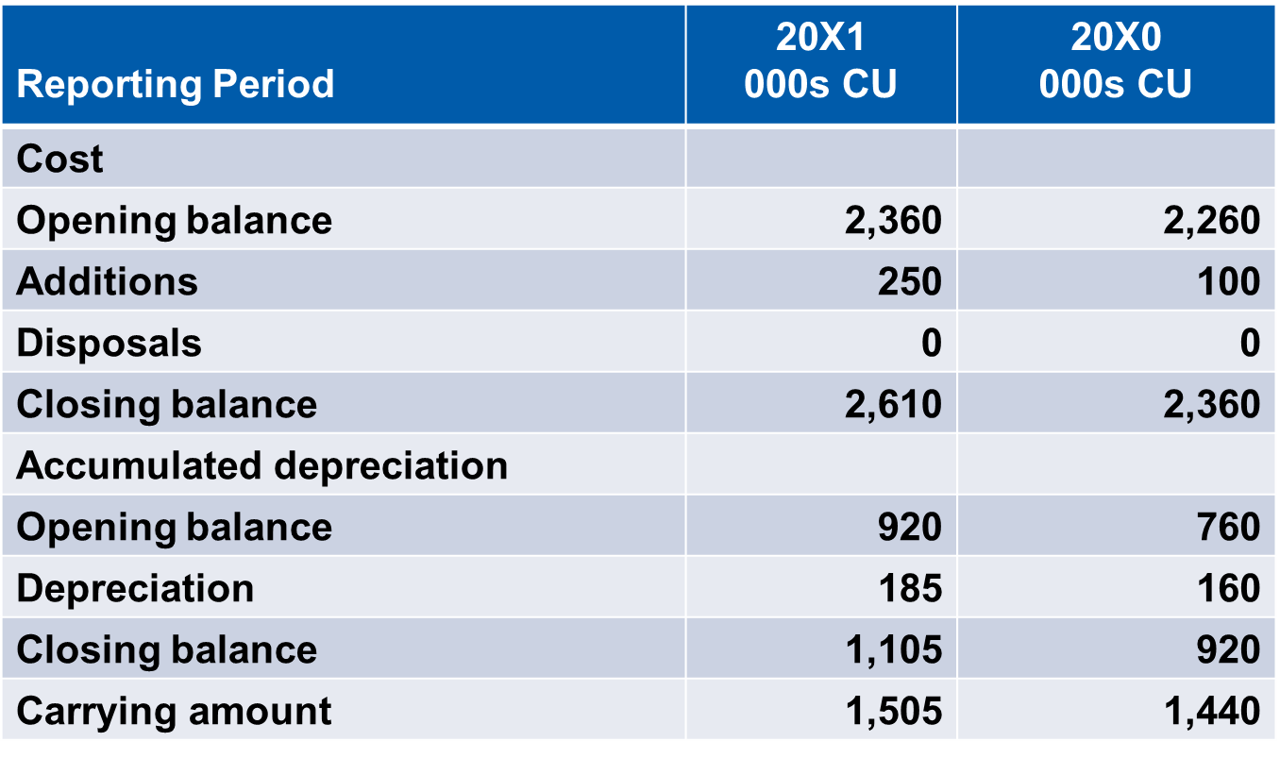
Illustrative Continuity Schedule - Building Class
Property, Plant and Equipment

Slide 23
Disclosure of Unrecognized Heritage Assets
Where heritage assets or a class of heritage assets are not recognized in the financial statements because, at initial measurement, its cost or current value cannot be measured reliably, the entity will need to disclose:
The difficulties in obtaining a reliable measurement that prevented recognition; and
The significance of the unrecognized heritage property, plant, and equipment in relation to delivery of the entity’s objectives.
Property, Plant and Equipment

Slide 24
Borrowing Costs – IPSAS 5
“Benchmark treatment” - borrowing costs expensed in the period incurred
“Allowed alternative treatment” - borrowing costs directly attributable to acquisition of qualifying asset included in cost
Qualifying asset is one that takes a substantial period of time to get ready for its intended use (PP&E, some inventories, intangible assets)
Guidance provided on which costs are eligible
Property, Plant and Equipment
Notes:
IPSAS 5 is based on an earlier version of IAS 23, Borrowing Costs that permitted the benchmark and alternative treatments. IAS 23 now mandates the capitalization of borrowing costs. If participants are familiar with IAS 23, this difference should be highlighted. The IPSASB confirmed the retention of the benchmark and alternative treatments in 2021.
IPSAS 5 provides guidance on which costs are eligible for capitalization under the allowed alternative treatment. Revised guidance has been included in IPSAS 5 that refers to IPSAS 41, Financial Instruments. IPSAS 41 is discussed in the Financial Instruments module.

Slide 25
Impairment – IPSAS 21 and IPSAS 26
A loss in future economic benefits or service potential in excess of depreciation
Assessed at each reporting date
IPSAS 21, Impairment of Non-Cash Generating Assets or IPSAS 26, Impairment of Cash Generating Assets
A cash-generating asset is held with the primary objective of generating commercial return
Non-cash-generating assets are all other assets
Asset is written down to recoverable amount if impaired
Property, Plant and Equipment
Notes:
IPSAS 21 and IPSAS 26 are based on IAS 36, Impairments of Assets.
IPSAS 26 is closely based in IAS 36. IPSAS 21 adapts the principles in IAS 36 to assets where cashflows cannot be used to assess the recoverable amount of the asset. Instead, recoverable service amount is assessed – this is the cost of replacing the service potential of the non-cash-generating asset, and some impairment indicators are modified – see next slide.
If participants are familiar with IAS 36, these differences should be highlighted.
Impairment of goodwill is discussed as part of public sector combinations in the consolidation module.

Slide 26
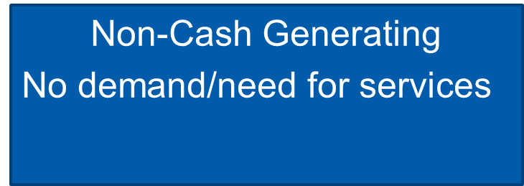
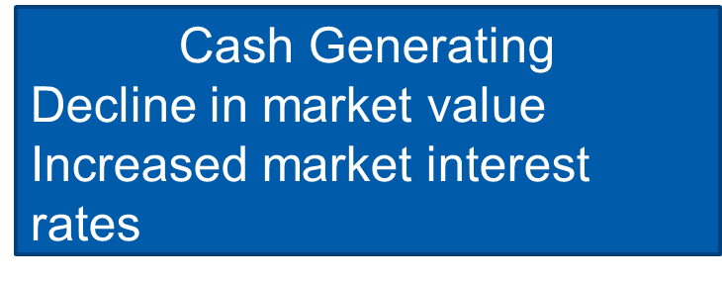
Property, Plant and Equipment
Notes:
See the Assets module for further details (page 39)

Slide 27
Questions and Discussion
Visit the IPSASB webpage http://www.ipsasb.org
Property, Plant and Equipment

