Slide 1
IMPLEMENTING IPSAS
Inventories
IPSAS® 12
2024 Edition
Notes:
IPSAS 12 is based on IAS 2, Inventories. Participants who are familiar with IAS 2 should be comfortable with IPSAS 12 as long as the key differences are noted.

Slide 2
The Handbook of International Public Sector Accounting Pronouncements is the primary authoritative source of international generally accepted accounting principles for public sector entities.
All information in this presentation is proprietary and copyrighted.
Inventories

Slide 3
Inventories – IPSAS 12
Definition
Materials or supplies to be
Consumed in a production process
Consumed or distributed in the rendering of services
Items held for sale or distribution in the ordinary course of operations (finished goods, land held for sale)
Work-in-progress
Inventories

Slide 4
Examples of Inventories
Military inventories (e.g., ammunition, missiles, rockets & bombs)
Consumables
Finished goods
Land and property held for sale
Maintenance materials
Spare parts
Strategic stockpiles such as energy reserves
Stocks of unused postal stamps and currency
Work-in-progress
Inventories
Notes:
Consider tailoring the list of examples to be relevant to participants.
Work-in-progress may not be common – examples include entities preparing legal documentation; and architects preparing drawings.
Costs incurred to fulfill a binding arrangement that does not give rise to inventories (or assets within the scope of another Standard) are accounted for in accordance with IPSAS 47, Revenue (see Module 4).

Slide 5
Measurement
Lower of cost and net realizable value (except as below)
Fair value when acquired in non-exchange transaction
Lower of cost and current replacement cost when held for distribution or consumption in production of goods to be distributed at no or nominal charge
Inventories
Notes:
The basic measurement principle (lower of cost and net realizable value) is consistent with IAS 2. IAS 2 does not include specific provisions for inventories acquired in non-exchange transactions or for inventory held for distribution or consumption in production of goods to be distributed at no or nominal charge.
Fair value is defined in IPSAS 46, Measurement
Net realizable value refers to the net amount that an entity expects to realize from the sale of inventory in the ordinary course of operations. It is an entity-specific value. Net realizable value for
inventories may not equal fair value less costs to sell of disposal.

Slide 6
Cost Components Example 1
An entity that maintains an inventory of lubricant makes the following transaction
Purchase = 10,000 liters @ CU5.00/liter
Container deposit = CU 1,000
Value added tax (refundable) = 10%
Shipping and handling = CU 1,500
Supplier discount = 5% on orders of 1000 liters or more
What is the cost of the inventory? Explain
Inventories
Notes:
The answer to this discussion question is provided in the Assets module (page 130).

Slide 7
Cost Components Example 2
At the fiscal year end a government has an inventory of educational preventive health care pamphlets, printed in-house, that it intends to distribute to citizens free of charge as part of a campaign aimed at reducing citizens’ dependence on the health care system. At the fiscal period end, it values the inventory at cost including direct labor, materials and attributable fixed and variable overheads.
Is this the correct valuation? Explain
Inventories
Notes:
Answer:
The proposed measurement of the inventory at cost including direct labor and directly attributable fixed and variable production overheads may not be correct. The pamphlets will be distributed at no charge. Inventories shall be measured at the lower of cost and current replacement cost where they are held for distribution at no charge or for a nominal charge.
Current replacement cost is the cost the entity would incur to acquire the asset on the reporting date. The government would have to test the current replacement cost against its cost of production to determine the appropriate value.

Slide 8
Inventory Costing Formulas
Inventories comprised of
Unique items or goods and services produced and segregated for specific projects shall be valued individually
Large numbers of interchangeable items valued using FIFO or weighted average cost formulas
Apply cost formula consistently
Inventories
Notes:
Consider whether the participants understand the FIFO and weighted average cost formulas. If not, consider additional slides explaining how the formulas work.

Slide 9
Measurement Exercise
A government uses weighted average method for its inventory of energy reserves. There are no costs for the sale, exchange, or distribution. At fiscal period end the units are trading at CU 20.
Units CU
Inventory , beginning of period 100 2,000
Purchased during period 50 1,750
Storage cost 500
Inventory, end of period 150 ?????
What is the value of the inventory at period end? Explain
Inventories
Notes:
The answer to this discussion question is provided in the Assets module (starting on page 131).

Slide 10
Expense Recognition
When sold, exchanged, or distributed the carrying amount is expensed in the period in which related revenue is recognized
If no related revenue, expensed when the goods are distributed or services rendered
Service providers recognize expense when services are rendered or billed
Write-downs or losses expensed when occur
Inventories

Slide 11
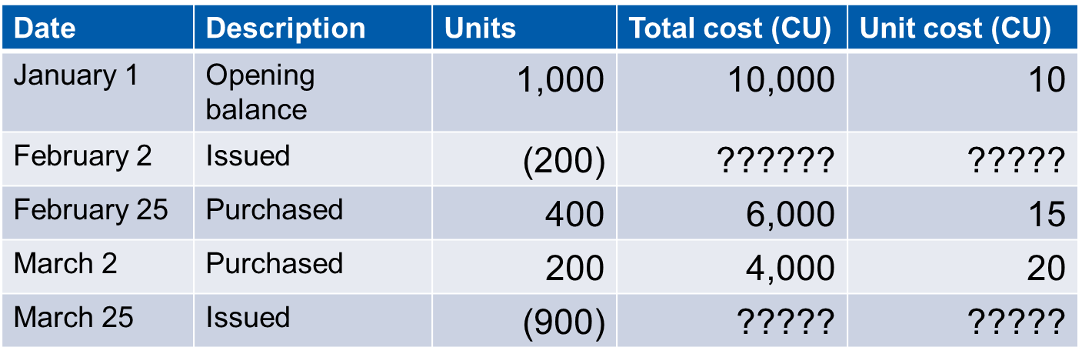
Expense Recognition Exercise
The following transactions relate to an inventory of granular material is used for maintenance.
What is the expense and the closing balance using the FIFO cost method?
Inventories
Notes:
The answer to this discussion question is provided in the Assets module (page 134).

Slide 12
Inventory Disclosures
Accounting policies
Amount by classification and in total
Amount of inventories carried at fair value
Amount recognized as an expense
Amount and circumstances for write downs or reversals
Amount pledged as security
Inventories

Slide 13
Questions and Discussion
Visit the IPSASB webpage http://www.ipsasb.org
Inventories

