Slide 1
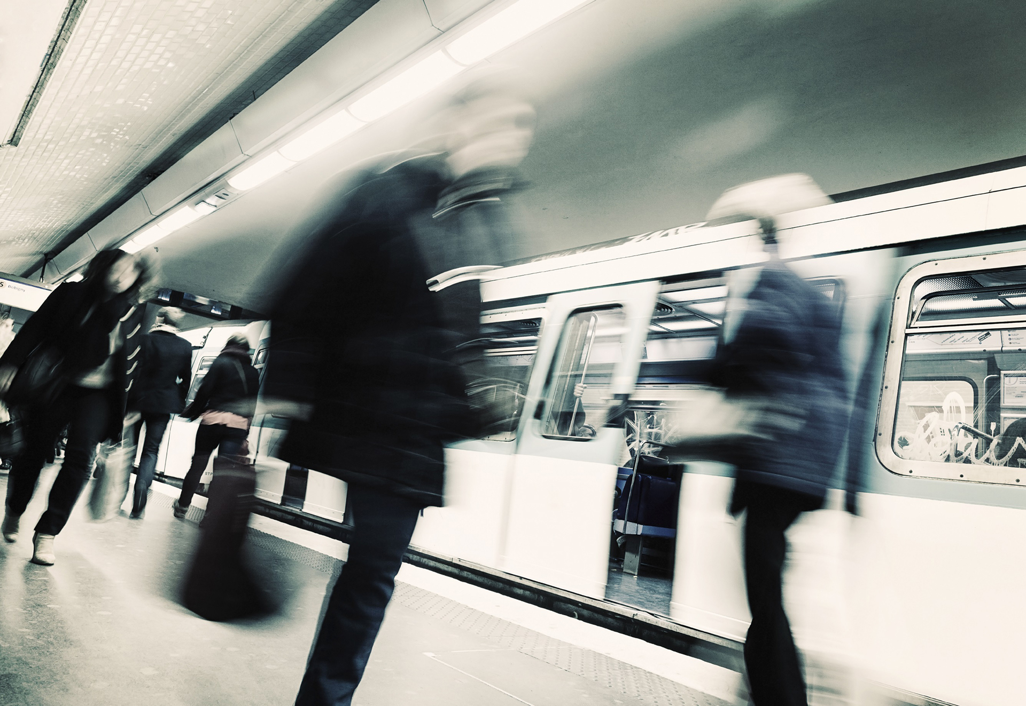
IMPLEMENTING IPSAS
Agriculture
IPSAS® 27
2024 Edition
Notes:
IPSAS 27 is based on IAS 41, Agriculture. Participants who are familiar with IAS 41 should be comfortable with IPSAS 27 as long as the key differences are noted.
The prevalence of agriculture in the public sector varies from jurisdiction to jurisdiction – consider whether this is a significant issue for the participants or not.

Slide 2
The Handbook of International Public Sector Accounting Pronouncements is the primary authoritative source of international generally accepted accounting principles for public sector entities.
All information in this presentation is proprietary and copyrighted.
Agriculture

Slide 3
Scope
Biological assets – living plant or animal (except bearer plants)
Agricultural produce – point of harvest
Excludes:
Land related to agricultural activity
Intangible assets related to agricultural activity
Biological assets held for provision or supply of services
Right-of-use assets arising from a lease of land related to agricultural activity
Agriculture
Notes:
Public sector can have lots of examples of biological asset held for the provision of services. Examples include:
Police / customs dogs
Police horses
Trees / flowers in public parks.
These items are accounted for under IPSAS 45, Property, Plant, and Equipment. If these are common, may wish to add a slide considering issues that will arise under that standard:
Depreciation period (e.g., life or service period)
When is the asset ready to bring into service (e.g. where training is required, this can be capitalized as part of an asset under construction)
Impairment (e.g., injury)

Slide 4
Bearer Plants
A bearer plant is a living plant that:
Is used in the production or supply of agricultural produce:
Is expected to bear produce for more than one period: and
Has a remote likelihood of being sold as agricultural produce, except for incidental scrap sales.
Bearer plants are accounted for in accordance with IPSAS 45
Agriculture
Notes:
Note that applies to plants only (but also compare with disclosures – bearer biological assets which includes animals).

Slide 5
Examples
Biological assets | Agricultural produce | Products – result of processing after harvest
Sheep | Wool | Yarn/carpet
Trees in timber plantation | Felled trees | Logs, lumber
Cotton plants | Harvested cotton | Thread, clothing
Dairy cattle | Milk | Cheese
Pigs | Carcass | Sausages, cured ham
Tea bushes | Picked leaves | Tea
Grape vines | Picked grapes | Wine
Fruit trees | Picked fruit | Processed fruit
Agriculture

Slide 6
Agricultural Activity
Management of biological transformation & harvest of biological assets
Diverse activities
Capability to change
Management of change
Measurement of change
Biological transformation results in asset changes or production of agricultural produce
Agriculture

Slide 7
Recognition
Recognize biological asset or agricultural produce when:
Entity controls asset as result of past event
Probable future economic benefits/service potential will flow to entity
Fair value or cost can be measured reliably
Agriculture
Notes:
Fair value is defined in IPSAS 46, Measurement, which also includes guidance on measuring fair value. See also Module 10.

Slide 8
Measurement at Initial Recognition
Measured at fair value less costs to sell
If non-exchange transaction, same
Agricultural produce harvested from biological assets measured at fair value less costs to sell at point of harvest
Grouping according to attributes allowed
Agriculture
Notes:
Fair value is defined in IPSAS 46, Measurement, which also includes guidance on measuring fair value. See also Module 10.

Slide 9
Subsequent Measurement
Measured at Fair Value less Costs to Sell at each reporting date
Agricultural Produce - Fair Value less Costs to Sell at point of harvest
Gains or losses – Recognized in Surplus or Deficit for the period in which they arise
Agriculture

Slide 10
Disclosure
Gain/loss on initial recognition
Consumable/bearer biological assets
Biological assets held for sale and those held for distribution at no/nominal charge
Nature of activities & estimates of physical quantities
Fair value measurement
Reconciliation
Agriculture
Notes:
See Assets module for more information on disclosures (page 145).

Slide 11
Questions and Discussion
Visit the IPSASB webpage http://www.ipsasb.org
Agriculture

