Slide 1
IMPLEMENTING IPSAS
Presentation of Financial Statements
Statements of Financial Position, Financial Performance, and Changes in Net Assets/Equity
IPSAS® 1
2024 Edition
Notes:
IPSAS 1 was based on IAS 1, Presentation of Financial Statements, and has many of the same core concepts (current/non-current presentation, materiality) for example, but the financial statements presented differ. For participants who are familiar with IAS 1, highlight the fact that there are differences in IPSAS 1.

Slide 2
The Handbook of International Public Sector Accounting Pronouncements is the primary authoritative source of international generally accepted accounting principles for public sector entities.
All information in this presentation is proprietary and copyrighted.
Presentation: Financial Statements

Slide 3
Objectives of Financial Statements
To meet information needs of service recipients and resource providers for accountability and decision making
Users need information about:
The performance of the entity e.g. meeting service delivery and other operating and financial objectives;
Managing resources it is responsible for
Complying with legislative & other authority
Liquidity and solvency
Sustainability of service delivery and other operations
Capacity to adapt to changing circumstances
Presentation: Financial Statements
Notes:
Consider a discussion about what information users need from financial statements. If presenting the training online, this could be done via chat, and would also be suitable for break-out groups.

Slide 4
Required Financial Statements
A complete set of financial statements includes:
Statement of financial position
Statement of financial performance
Statement of changes in net assets/equity
Cash flow statement
Comparison of budget and actual amounts
Notes
Comparative information in respect of the preceeding period
Presentation: Financial Statements
Notes:
Note that while IPSAS uses this terminology, it permits other terminology to be used where the meaning is clear – some jurisdictions will still refer to a balance sheet.
For participants who are familiar with IFRS, consider highlighting that the statements required are broadly similar to those required by IFRS (although different terminology is used). IFRS does not require a comparison of budgets and actuals. Details of the individual statements differ, and IPSAS 1 does not present Other Comprehensive Income (OCI), which is used in IAS 1. Amounts that would appear in OCI under IAS 1 would be reported in the Statement of Changes in Nets Assets/Equity under IPSAS 1.

Slide 5
Comparative Information
Required for previous period for all amounts reported
Included for narrative and descriptive information when relevant to understanding
Presentation: Financial Statements

Slide 6
Presentation and Disclosure
Consistency of presentation and classification in financial statements is retained unless
Another is more appropriate
An IPSAS requires a change
If changed, comparative amounts reclassified
Disclosure for reclassified items or classes of item
Disclosure on face of statements or in notes
Presentation: Financial Statements
Notes:
Further details are provided in the Presentation module

Slide 7
Materiality and Aggregation
Each material class of similar items shall be presented separately
Items of a dissimilar nature or function shall be presented separately unless immaterial
Specific requirements in IPSASs need not be satisfied if information immaterial
Presentation: Financial Statements
Notes:
The materiality requirements are similar to those in IFRS and in auditing standards (ISA / ISSAI). If participants are familiar with other standards, highlight this issue.
Understanding materiality can be key in assisting with the first-time adoption of accrual basis IPSAS, and can help avoid spending a lot of time on non-material items. If participants are not familiar with the materiality concept, consider a discussion session (which could be via chat if online).
The materiality requirements in IPSAS are summarized in a staff Q&A document - https://www.ifac.org/system/files/publications/files/IPSASB-Staff-Q-and-A-Materiality.pdf

Slide 8
Offsetting
Assets and liabilities, and revenue and expenses shall not be offset
Measuring assets net of valuation allowances is not offsetting
Netting of revenue and expenses may be appropriate if it reflects the substance of the transaction
Presentation: Financial Statements
Notes:
Valuation allowances may be used as a means of restating items – e.g., an obsolescence allowance for inventory or a doubtful debts allowance for receivables. Measuring these items net of the valuation allowance is not offsetting; it is a means of moving from the previous carrying amount to the new carrying amount required by other IPSAS (the alternative being to revalue the item directly).

Slide 9
Minimum Disclosures on Statement
of Financial Position
ASSETS
Property, plant and equipment
Investment property
Intangible assets
Financial assets
Investments (equity method)
Inventories
Receivables
Cash and cash equivalents
Total of assets classified as held for sale and assets in disposal groups classified as held for sale
LIABILITIES
Taxes and transfers payable
Social benefit liabilities
Payables
Provisions
Financial liabilities
Liabilities included in disposal groups classified as held for sale
Non-controlling interests
NET ASSETS/EQUITY
Additional items relevant to understanding statements
Presentation: Financial Statements

Slide 10
Current/Non-current Distinction
Statement of financial position presents current and non-current assets and liabilities separately
Current asset is cash or cash equivalents or item expected to be realized within twelve months after the reporting date
Current liability is expected to be settled within twelve months after the reporting date
Presentation: Financial Statements

Slide 11
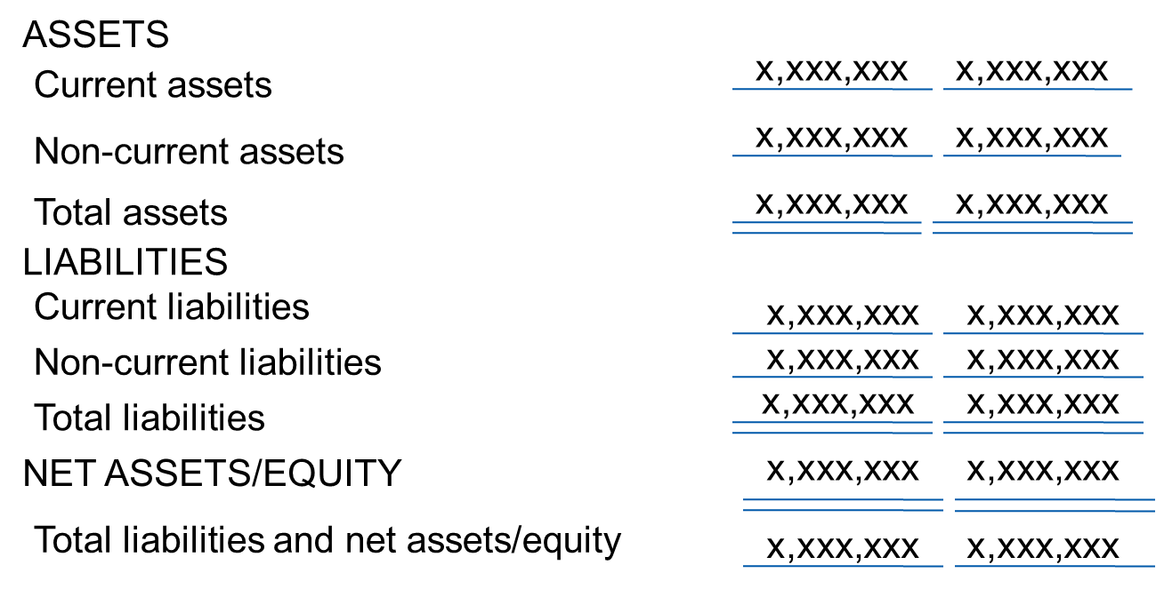
Public Sector Entity Consolidated Statement of Financial Position As at December 31, 20X2 (in thousands of currency units)
Presentation: Financial Statements
Notes:
Highlight information shown:
Statement of Financial Position is clearly identified
The name of the reporting entity;
The financial statements cover the economic entity;
The reporting date (appropriate for this component of the financial statements);
The presentation currency; and
The level of rounding used.
Distinction between current and noncurrent assets and liabilities; and
Net assets/equity.
IPSAS 1 requires presentation of specific sub-classifications of assets, liabilities and net assets/equity be shown on the face of the statement. This has not been illustrated due to space limitations.

Slide 12
Statement of Financial Performance
As a minimum, the face of the statement includes:
Revenue, presenting separately:
Interest revenue calculated using the effective interest method
Gains and losses arising from the derecognition of financial assets measured at amortized cost;
Finance costs
Impairment losses
Share of the surplus or deficit of associates and joint ventures
Gains or losses on reclassification of financial assets
Surplus or deficit
A single amount for the total of discontinued operations
Additional items are presented if relevant to users understanding of financial performance
Presentation: Financial Statements
Notes:
Gains or losses on reclassification cover (presented separately):
If a financial asset is reclassified out of the amortized cost measurement category so that it is measured at fair value through surplus or deficit, any gain or loss arising from a difference between the previous amortized cost of the financial asset and its fair value at the reclassification date
If a financial asset is reclassified out of the fair value through net asset/equity measurement category so that it is measured at fair value through surplus or deficit, any cumulative gain or loss previously recognized in net assets/equity that is reclassified to surplus or deficit
IPSAS 41 provides further details on reclassifying financial assets.

Slide 13
Items Presented on Face or in Notes
Revenue by operations
Analysis of expenses classified by nature or function
Material revenues and expenses such as
Revenue by operations
Write-downs and reversals
Restructuring costs
Gains or losses on disposals
Reversals of provisions
Other unusual or material items
Presentation: Financial Statements
Notes:
These are examples; see the Presentation module for further examples.

Slide 14
Expenses Classified by Nature
Revenues
X,XXX,XXX
Expenses
Employee benefits
(X,XXX,XXX)
Grants & other transfers payments
(X,XXX,XXX)
Depreciation & amortization
(X,XXX,XXX)
Other expenses
(X,XXX,XXX)
Total expenses
(X,XXX,XXX)
Surplus/(deficit) for continuing operations
X,XXX,XXX
Presentation: Financial Statements
Notes:
This example shows expenses classified by nature. Consider a discussion (using chat or break-out rooms if delivering the training online) about what other items may be relevant to the participants’ organizations.
The COVID-19 pandemic may have caused entities to take on new type of expenditure – consider a discussion as to whether any of the participants’ organizations have undertaken new activities that would require separate presentation when expenses are classified by nature. For example, have entities given grants to individuals or organizations for the first time?

Slide 15
Expenses by Functional Classification
Revenues
X,XXX,XXX
Expenses
Health
(X,XXX,XXX)
Education
(X,XXX,XXX)
Social protection
(X,XXX,XXX)
Other expenses
(X,XXX,XXX)
Total expenses
(X,XXX,XXX)
Surplus/(deficit) for continuing operations
X,XXX,XXX
Presentation: Financial Statements
Notes:
This example shows expenses classified by functions. Consider a discussion (using chat or break-out rooms if delivering the training online) about what other items may be relevant to the participants’ organizations. This example is most likely to apply to the consolidated financial statements of a government; what would be relevant for a lower level entity, for example a government ministry?
The COVID-19 pandemic may have caused entities to take on new type of expenditure – consider a discussion as to whether any of the participants’ organizations have undertaken new activities that would require separate presentation when expenses are classified by function. For example, have entities established new “test and trace” functions?

Slide 16
Public Sector Entity Consolidated Statement of Financial Performance For the Year Ended December 31, 20X2 (in thousands of currency units)
 | 20X2 | 20X1
Revenues
Taxes | x,xxx,xxx | x,xxx,xxx
Fees, fines, penalties and licenses | x,xxx,xxx | x,xxx,xxx
Transfers from other governments | x,xxx,xxx | x,xxx,xxx
Other revenue | x,xxx,xxx | x,xxx,xxx
Total revenue | x,xxx,xxx | x,xxx,xxx
Expenses
General government | x,xxx,xxx | x,xxx,xxx
Public order and safety | x,xxx,xxx | x,xxx,xxx
Social protection | x,xxx,xxx | x,xxx,xxx
Total expenses | x,xxx,xxx | x,xxx,xxx
Surplus/Deficit for the period from continuing operations | x,xxx,xxx | x,xxx,xxx
Gain/Loss from discontinued operations | x,xxx,xxx | x,xxx,xxx
Surplus/Deficit for the period | x,xxx,xxx | x,xxx,xxx
Presentation: Financial Statements

Slide 17
Statement of Changes in Net Assets/Equity
Statement of changes in net assets/equity required showing on the face
Surplus or deficit for the period
Revenue and expense recognized directly in net assets/equity
Total revenue and expense for the period (the sum of above) – attributable to owners & to minority interest
Effects of changes in accounting policies
Presentation: Financial Statements

Slide 18
Statement of Changes in Net Assets/Equity (continued)
On the face or in notes
Transactions with owners, showing distributions separately
Balance of accumulated surpluses or deficits at beginning and end of period and changes during the period
Reconciliation for each component of net assets/equity beginning and end
Presentation: Financial Statements
Notes:
Components of net assets/equity may be required by an IPSAS (for example a revaluation reserve for revalued property, plant and equipment) or may be established by a public sector entity (for example, specific reserves). Consider a discussion (using chat or break-out rooms if delivering the training online) about which components would be relevant to the participants’ organizations.

Slide 19
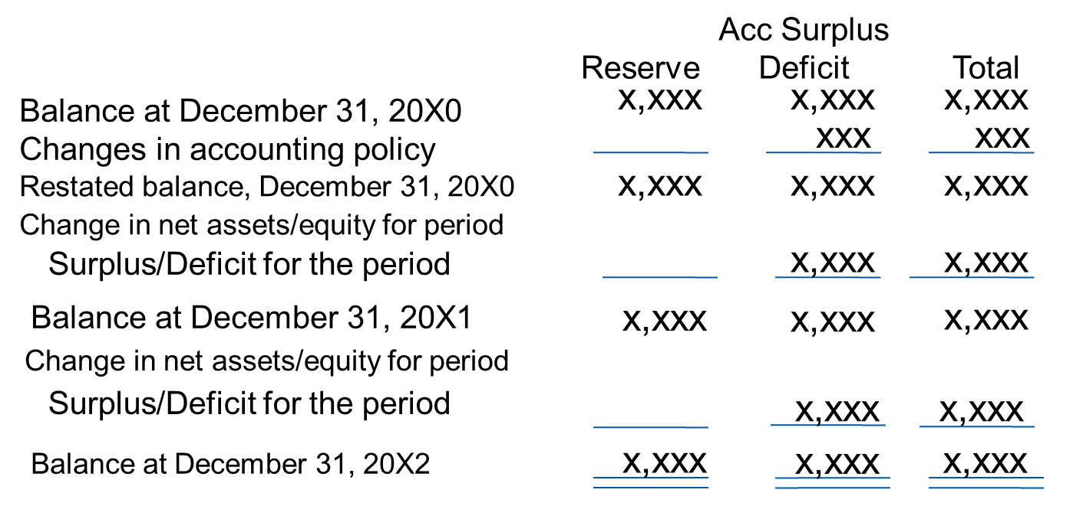
Public Sector Entity Consolidated Statement of Changes in Net Assets/Equity For the Year Ended December 31, 20X2 (in thousands of currency units)
Presentation: Financial Statements
Notes:
Note each of the elements presented (name of the entity, currency, etc.
The change in net assets/equity for each period presented results only from a surplus or deficit. There are no items of revenue and expense for the periods presented that, as required by other standards, is recognized directly in net assets/equity. Therefore the total revenue and expense for the period is the surplus for the period. In this illustration there are no amounts attributable to owners of the controlling entity and to minority interests.

Slide 20
Notes to Financial Statements
Present information about the basis of preparation of the financial statements and the specific accounting policies
Disclose required information not presented on the face of statements and
Provide additional information
Significant judgments made
Information about estimation uncertainty
Presentation: Financial Statements

Slide 21
Questions and Discussion
Visit the IPSASB web site http://www.ipsasb.org
Presentation: Financial Statements

