Slide 1
IMPLEMENTING IPSAS
Cash Flow Statement
IPSAS® 2
2024 Edition
Notes:
IPSAS 2 is based on IAS 7. If participants are familiar with IFRS, consider highlighting this fact.

Slide 2
The Handbook of International Public Sector Accounting Pronouncements is the primary authoritative source of international generally accepted accounting principles for public sector entities.
All information in this presentation is proprietary and copyrighted.
Presentation: Cash Flow Statement

Slide 3
Objective of Cash Flow Statement
Mandatory
Provides users with basis to assess how entity generates and uses cash
Users can assess effect activities had on financial position
Information has predictive value
Amounts, timing and certainty of future cash flows
Future cash requirements
Sustainability of activities
Presentation: Cash Flow Statement

Slide 4
Cash and Cash Equivalents
Cash
Cash
Demand deposits
Cash Equivalents
Short-term liquid investments (3 months or less)
Readily convertible
Insignificant risk
Components must be disclosed
Presentation: Cash Flow Statement
Notes:
Cash equivalents are an important element of cash flow statements. Participants who are familiar with IAS 7 will be aware of cash equivalents. Cash equivalents are also used in the Cash Basis IPSAS, so participants who are familiar with that Standard should also be aware of cash equivalents. However, for participants who only have experience of other cash accounting frameworks, this may be a new concept. Consider a show of hands (or a poll online) to see how many participants are aware of cash equivalents. I the number is small, consider a discussion (chat or break-out room online).
There are discussion points on the next slide.

Slide 5
Cash and Cash Equivalents
Scenario 1
An entity acquires a three year fixed rate government bond in an active market two months before its maturity.
Is the bond cash and cash equivalent? Explain
Presentation: Cash Flow Statement
Notes:
Consider a discussion on these scenarios (using chat or break-out rooms if delivering the training online).
Answer:
The investment is a cash equivalent. It is short term (maturity date within two months of purchase date), highly liquid (traded in active market), readily converted to a known amount of cash (capital plus interest at maturity or at market value if sold before maturity) and subject to an insignificant risk of changes in value (government bond with fixed interest rate close to maturity unlikely to fluctuate significantly in value).

Slide 6
Cash and Cash Equivalents
Scenario 2
An entity’s general bank fluctuates between having a balance and overdraft in accordance with the entity’s cash receipts and payments cycle. The overdraft is repayable on demand.
Is overdraft part of cash and cash equivalents? Explain
Presentation: Cash Flow Statement
Notes:
Consider a discussion on these scenarios (using chat or break-out rooms if delivering the training online).
Answer:
The bank overdraft is a cash equivalent. It is repayable on demand and forms an integral part of the entity’s cash management.

Slide 7
Cash Flow Statement
Report cash flows classified by:
Operating activities - derived from main cash-generating activities e.g. revenue from taxes, payments to suppliers
Investing activities - purchase/sale of assets and other long-term investments for resources contributing to future service delivery
Financing activities - changes in the size and composition of contributed capital and borrowings of entity e.g. payment of interest; issuance of debt
Presentation: Cash Flow Statement
Notes:
Further examples of operation activities, investing activities and financing activities are included in the Presentation module (pages 24 – 25).
Consider adding a poll / show of hands to see if participants can classify cash flows appropriately.

Slide 8
Reporting Operating Activities
Direct Method
Discloses
major classes of gross cash receipts
gross cash payments
Indirect Method
Surplus/deficit adjusted for
noncash transactions
deferrals
accruals
Use of direct method preferred
Presentation: Cash Flow Statement
Notes:
IPSAS notes that the use of the direct method is preferred, as this provides more useful information for users. However, systems need to be in place to identify cash flows separately from accrual entries, and many entities use the indirect method for simplicity. Entities that have previously used cash accounting may have the cash recording systems needed to use the direct method.
Consider a discussion with participants about which approach their organization is using or is planning to use. If the training is being delivered online, this would be suitable for a poll or chat (if discussing reasons).

Slide 9
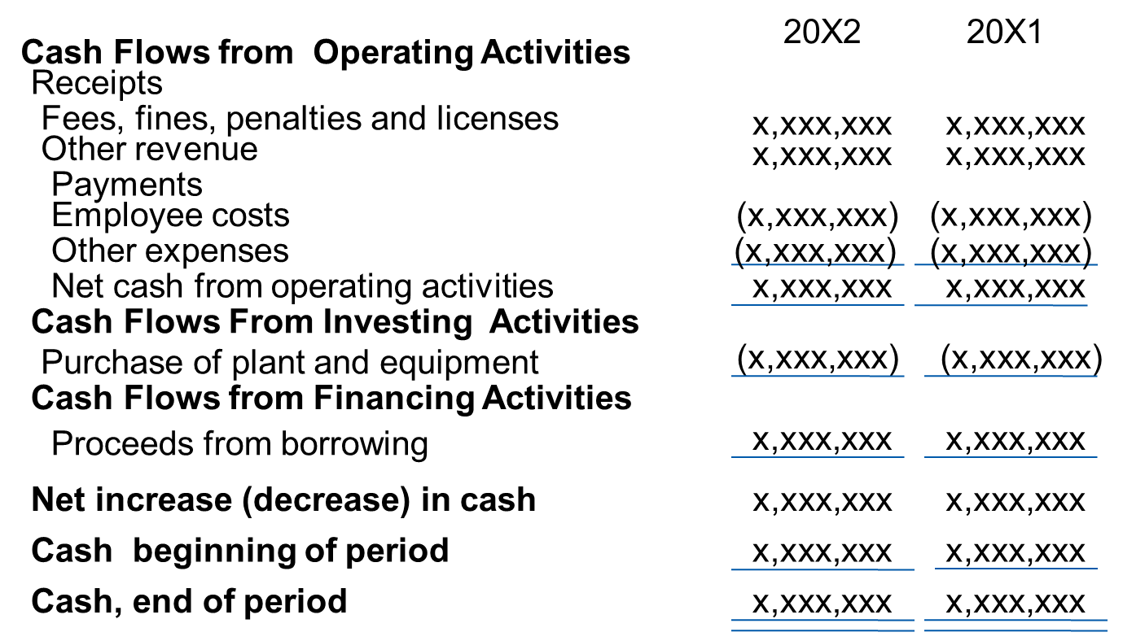
Public Sector Entity Consolidated Statement of Cash Flows (Direct Method) For the Year Ended December 31, 20X2 (in thousands of currency units)
Presentation: Cash Flow Statement

Slide 10
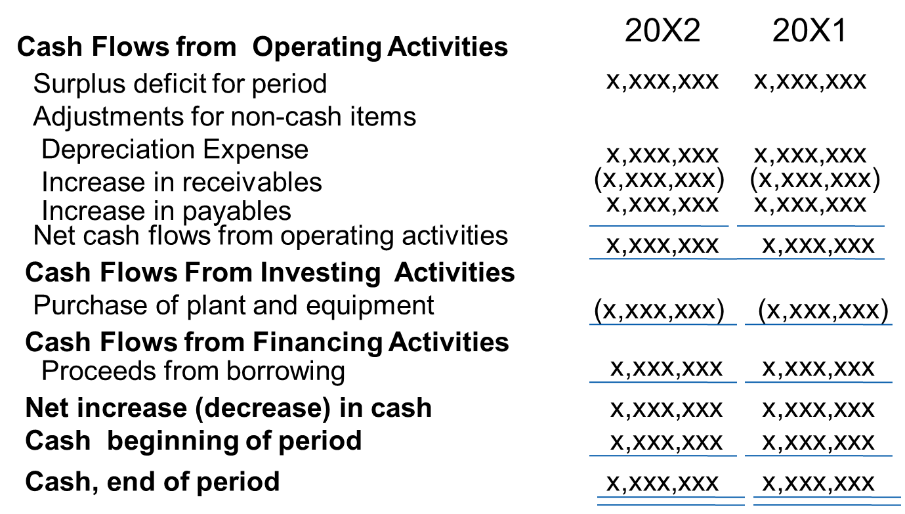
Public Sector Entity Consolidated Statement of Cash Flows (Indirect Method) For the Year Ended December 31, 20X2 (in thousands of currency units)
Presentation: Cash Flow Statement

Slide 11
Netting
Cash flows may be reported on a net basis when:
Cash receipts collected and payments made on behalf of others (e.g. collection of taxes by one level of government for another level of government)
Cash receipts and payments when
Turnover is quick
Amounts are large
Maturities are short
(e.g. purchase and sale of investments)
Presentation: Cash Flow Statement

Slide 12
Disclosures
Changes in liabilities arising from financing activities
Components of cash and cash equivalents
Additional information relevant to users in understanding the financial position and liquidity of entity
Amount of undrawn borrowing facilities and restrictions
Cash flows from interests in joint ventures
Amount and nature of restricted cash balances
Reconciliation of the surplus/deficit with net cash flow from operating activities when direct method used
Presentation: Cash Flow Statement

Slide 13
Questions and Discussion
Visit the IPSASB web site http://www.ipsasb.org
Presentation: Cash Flow Statement

